Slide 1
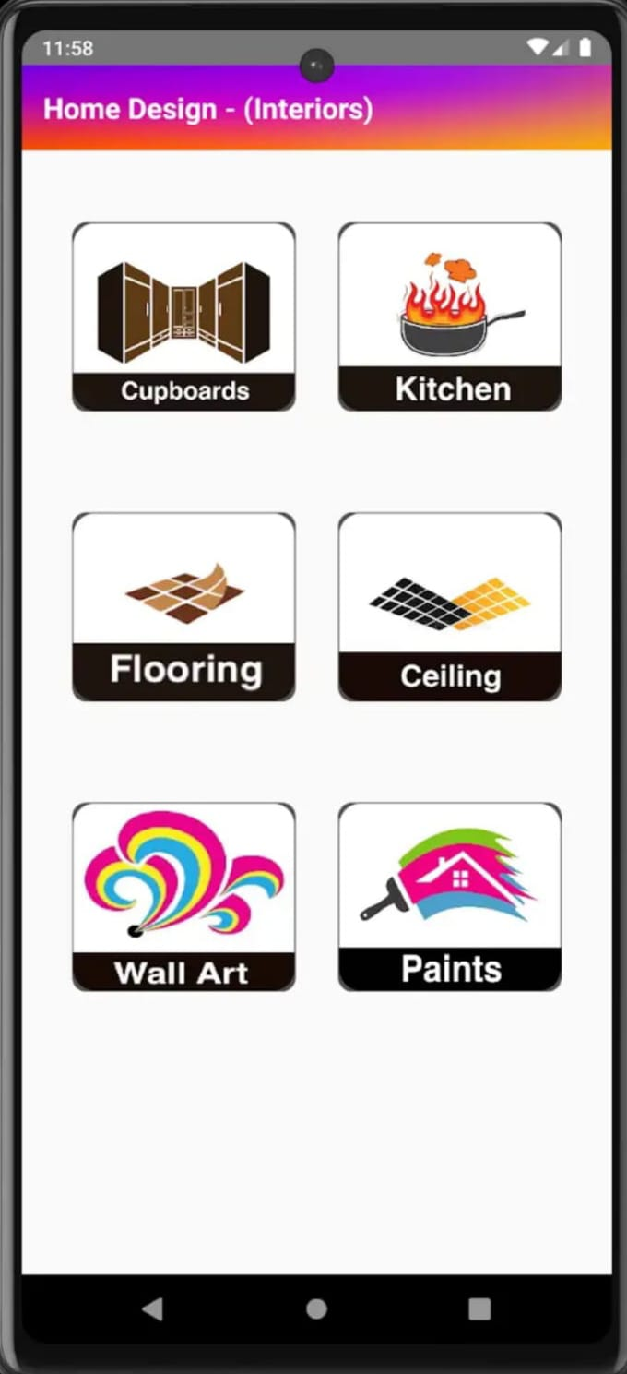
An Android Based Application For Revolutionizing Home Design
BATCH- IT-1
K.V. Hemanth -207Z1A1225
Sheldon Shaji -207Z1A1241
V.Nikil -207Z1A1248

Slide 2

MODULES
UI/UX Designs
User Authentication
Customer Support
Interior
Exterior

Slide 3
UI/UX DESIGNS
The UI is meticulously crafted, featuring user-friendly screens, intuitive buttons, and visually appealing toggles and icons.
These elements ensure a seamless and visually pleasing navigation experience.
The UX, however, goes beyond visuals, focusing on the overall interaction users have with the product.
The splash screen with the logo enhances the initial interaction, contributing to a holistic and satisfying user experience.

Slide 4
USER AUTHENTICATION
Enable seamless Google login in the Home Design Module for quick access.
Users opt for Google authentication, redirecting to Google's login where OAuth 2.0 ensures secure authorization.
After user consent, the Home Design Module creates an account, leveraging Google-authenticated credentials for subsequent logins.
This streamlined process enhances user convenience by eliminating the need for separate login credentials while maintaining security through Google's authentication protocols.

Slide 5
CUSTOMER SUPPORT
It is available for quick doubt clarification.
Users can quickly reach out, ask questions, and receive clarifications on application features.
Enhance your home planning experience with our reliable and efficient customer support.
Regular updates and user-friendly guides are also provided to enhance user understanding.

Slide 6
INTERIOR
It is a guide to all interior designs
It will provide the resources like wall arts, ceiling , Flooring, Paintings, Kitchen, Cupboards.
In each resource it provides more options for various types of designs and styles.
It lets you zoom in and zoom out for more clear view.

Slide 7
EXTERIOR
It will provides the house layouts of the 150 sq.yards, 200 sq.yards, 250 sq.yards of the land.
It also lets you select the facing of the house.
It lets us select the internal layout of the home and select as you like them in the provided layouts.
It lets you zoom in and zoom out for more clear view.

Slide 8
THANK YOU

